Slide 1
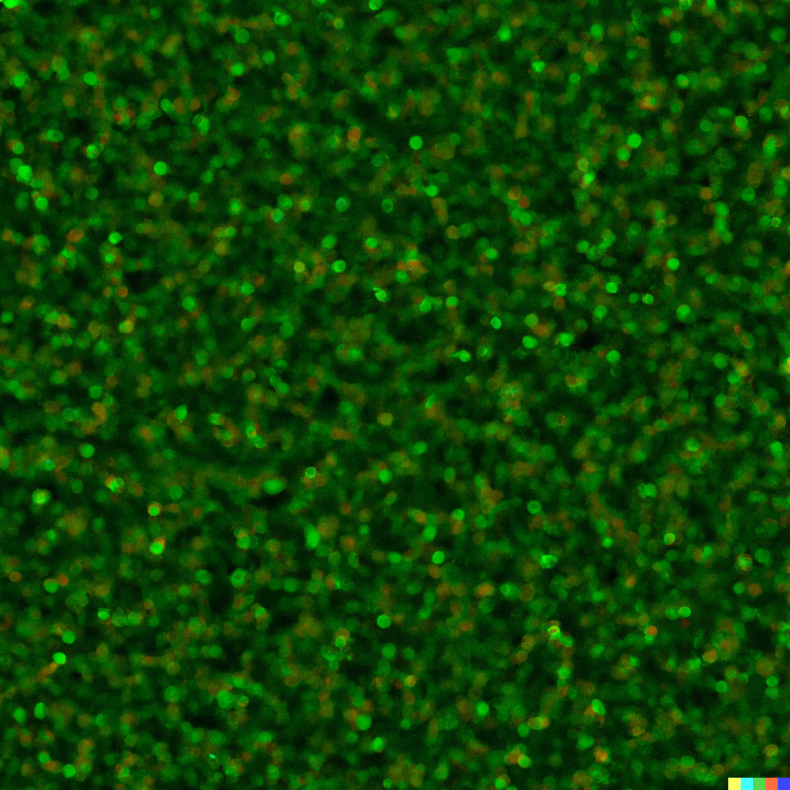
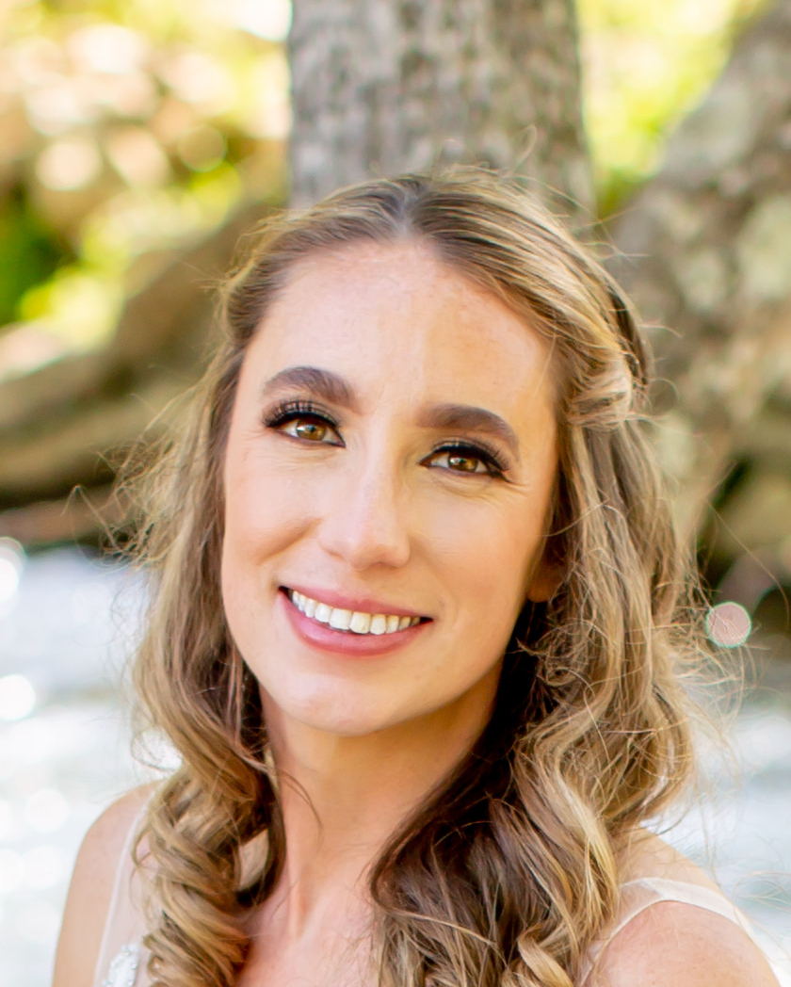

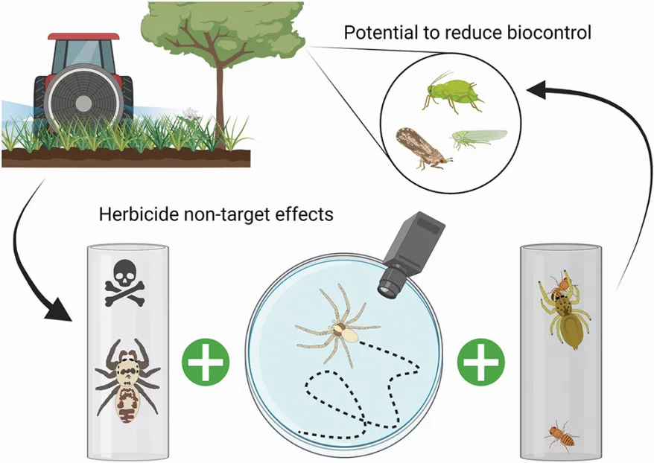
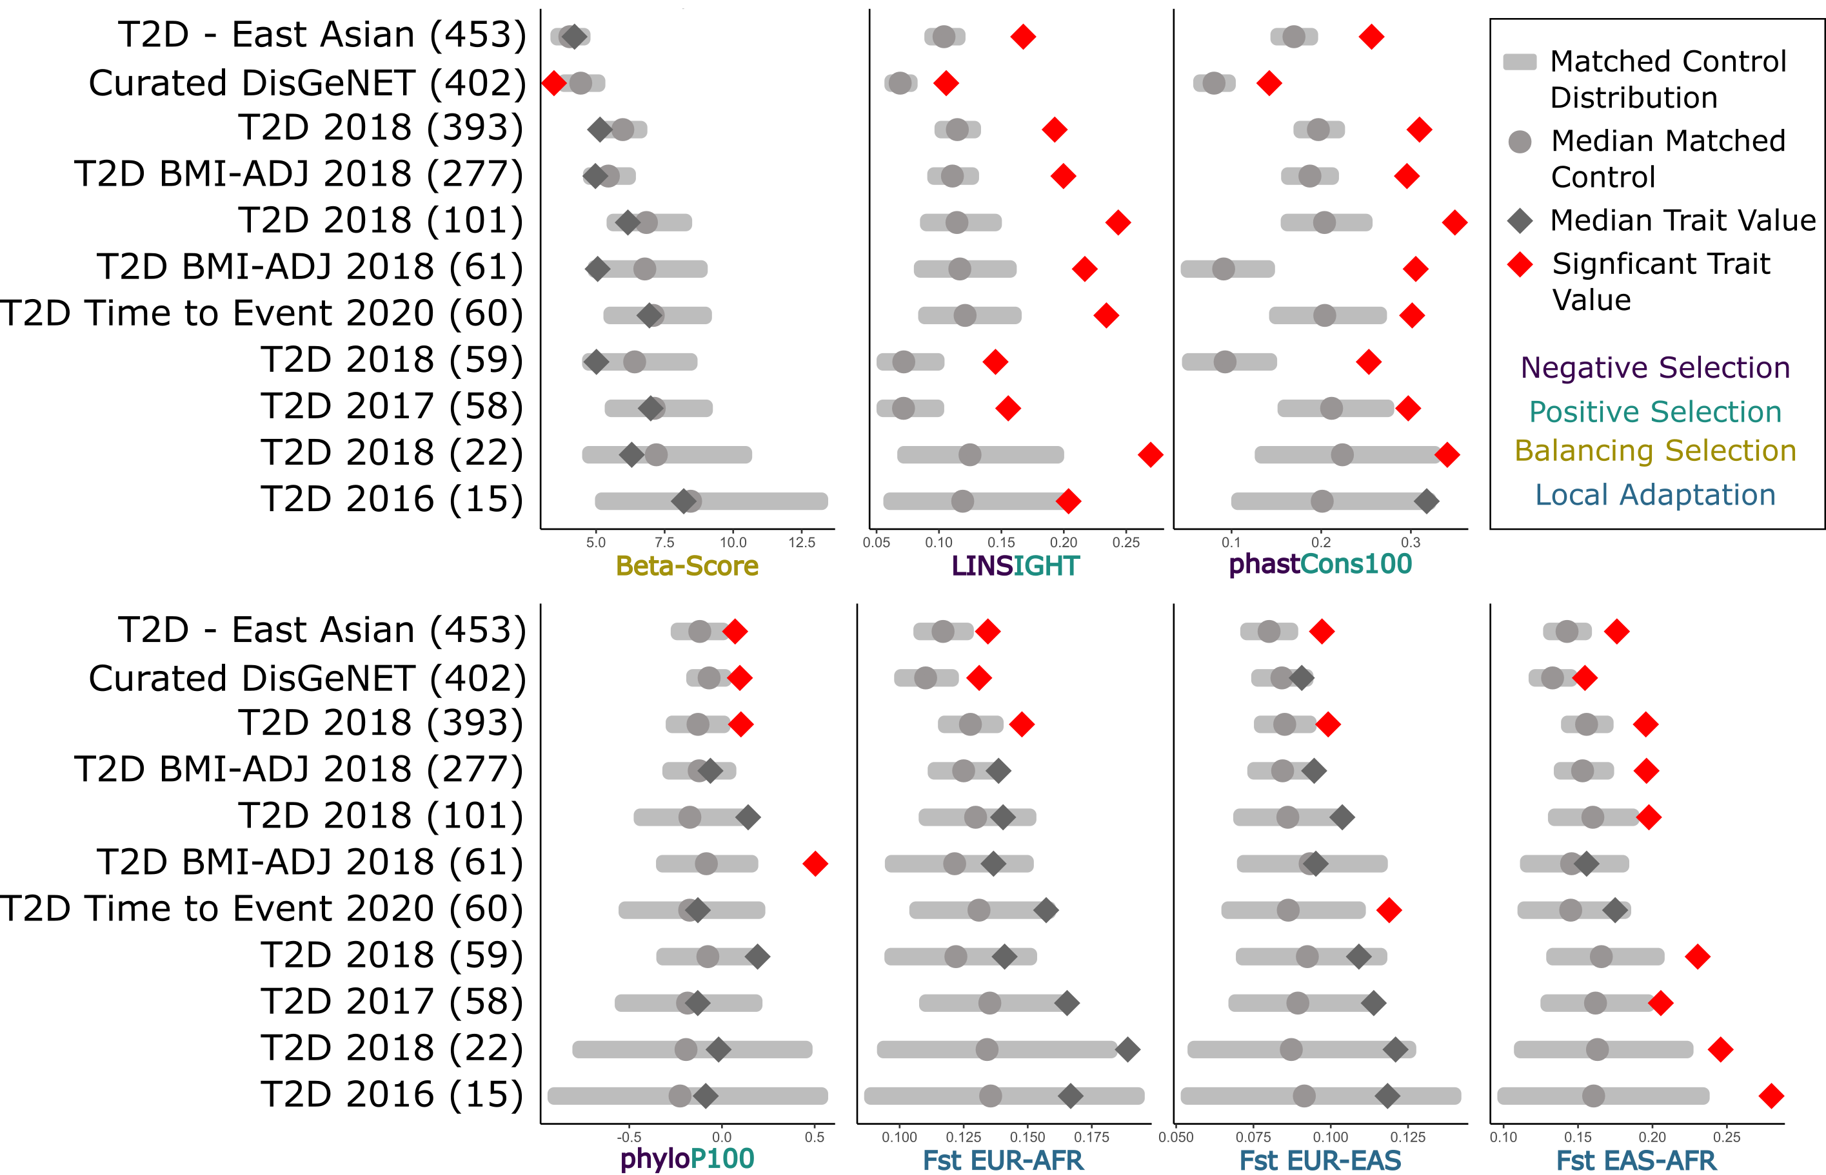
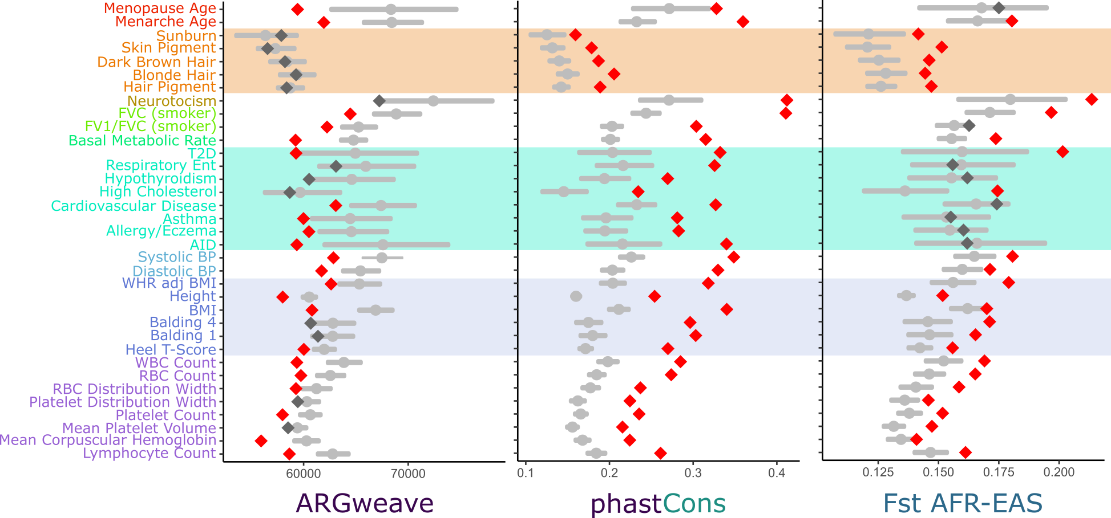
Characterization of the Evolutionary Forces Acting on Genomic Regions Associated with >600 Human Complex Traits
Abigail LaBella^{†1}, Abin Abraham^{†2,3}, John A. Capra*⁴ , Antonis Rokas*¹
†Co-First, *Co-corresponding, 1. Department of Biological Sciences, Vanderbilt University, Nashville, TN USA 2. Medical Scientist Training Program, Vanderbilt University, Nashville, TN, USA
3. Vanderbilt Genetics Institute, VUMC, Nashville, TN, USA 4. Bakar Computational Health Sciences Institute and Department of Epidemiology and Biostatistics, University of California, San Francisco, San Francisco, CA 94143, USA
Abigail Leavitt LaBella
Abigail.l.labella@vanderbilt.edu
Twitter: @abbeatsea
Website: abigailleavittlabella.com
What are we studying and why are we studying it? Details can be found here
Methods section or
Results number 1
Whichever you have more of
Another figure and conclusions will go in this section. These sections can be resized to ensure that you have enough room for long or wide. You can even make a 3rd column
Use this section to introduce the background of your study. An introductory figure our graphical abstract would go here
You can even use bullet points if that’s helpful
Point 2
Point 3
Our hypothesis is that this science will be cool and interesting
Outline the methods briefly. You can use a flow chart if that’s helpful.
In the experiment designed to gauge public attention to scientific presentations, scientists utilized a variety of innovative methods.
We crafted captivating and visually appealing presentations with simplified language to make complex concepts accessible.
We organized public lectures and online webinars open to experts and laypeople alike.
We monitored social media platforms to track conversations and discussions related to their research
We organized a series of public lectures and online webinars, inviting both experts in the field and laypeople. In addition, they monitored social media channels to gauge public discussions about their research
Fig 3: Figure Title. These results were super interesting. And they revealed a lot about what we were looking into. This prompted us to look into other features of this research which we will discuss below
Conclusions: This is where your conclusions go. Make sure to lay out the main points you want to get across
This research was cool
We learned a lot from this research
This research will lead to more research
Fig 1: Figure Title. Describe the figure here. Provide more detail associated with your figure than anywhere else. In an age where the sheer volume of information vies for our attention, scientists are increasingly concerned about whether their research is truly making an impact. To address this concern, a novel experiment was designed to explore the often elusive question: "Is anyone paying attention to the science we are presenting?"This experiment sought to bridge the gap between the scientific community and the general public.
Fig 4. Figure Title. There are differences in both the absolute value and enrichment between pigment (orange), disease (teal) and body-size (purple) traits.
Fig 2: Figure Title. Describe all of your results here. The results of this experiment were illuminating. While some scientific endeavors garnered significant attention, others were met with relative obscurity. These findings prompted scientists to rethink their communication strategies.
Acknowledgements: This work was supported by the National Institutes of Health (grant R35GM127087 to J.A.C), the Burroughs Wellcome Fund Preterm Birth Initiative (to J.A.C and A.R.), and by the March of Dimes through the March of Dimes Prematurity Research Center Ohio Collaborative (to L.J.M., G.Z., P.A., J.A.C., and A.R.). A.A. was also supported by American Heart Association fellowship 20PRE35080073 and NIGMS of the National Institutes of Health under award number T32GM007347. This work was conducted in part using the resources of the Advanced Computing Center for Research and Education at Vanderbilt University. The content is solely the responsibility of the authors and does not necessarily represent the official views of the National Institutes of Health, the March of Dimes, or the Burroughs Wellcome Fund.
Citations: LaBella AL, Abraham A, Pichkar Y, Fong SL, Zhang G, Muglia LJ, Abbot P, Rokas A, Capra JA. Accounting for diverse evolutionary forces reveals mosaic patterns of selection on human preterm birth loci. Nature communications. 2020 Jul 24;11(1):1-2.
Loh PR, Kichaev G, Gazal S, Schoech AP, Price AL. Mixed-model association for biobank-scale datasets. Nature genetics. 2018 Jul;50(7):906-8.
MOSAIc Pipeline: https://github.com/abraham-abin13/gsel_vec
Notes:
BANNER BACKGROUND – this was generated using DALE-2. This is the place to add a little punch or visual excitement
COLORS –The exact UNC Charlotte colors can be found here: https://brand.charlotte.edu/visual-identity/color-palette/
Icons – I really like getting icons from https://www.flaticon.com/
Yes, you should include a picture of yourself with your contact information. There are times at conferences where you may not be in front of your poster. This allows people to find you if they have questions or want to get in touch

